Slide 1
TechCamp Speed Geeking

Slide 2
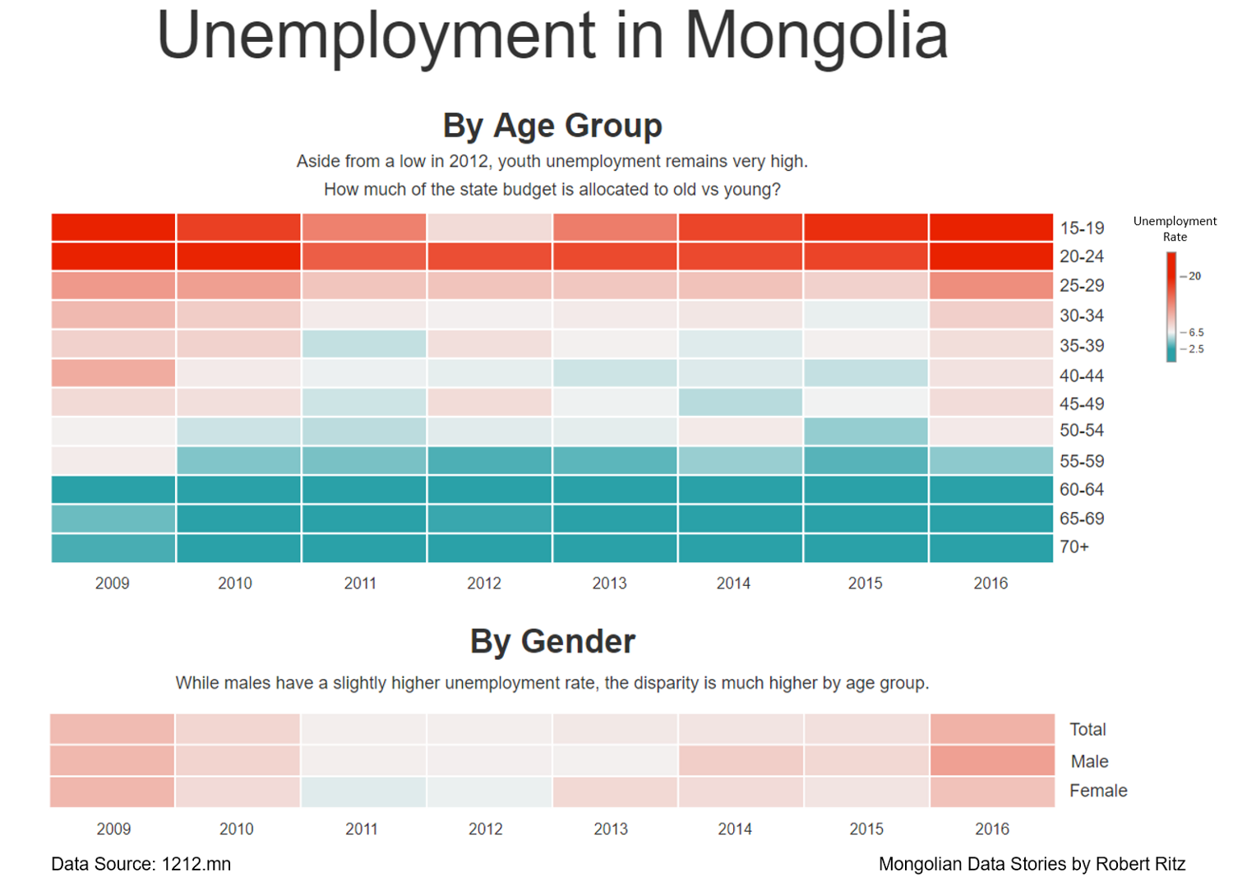

Slide 3
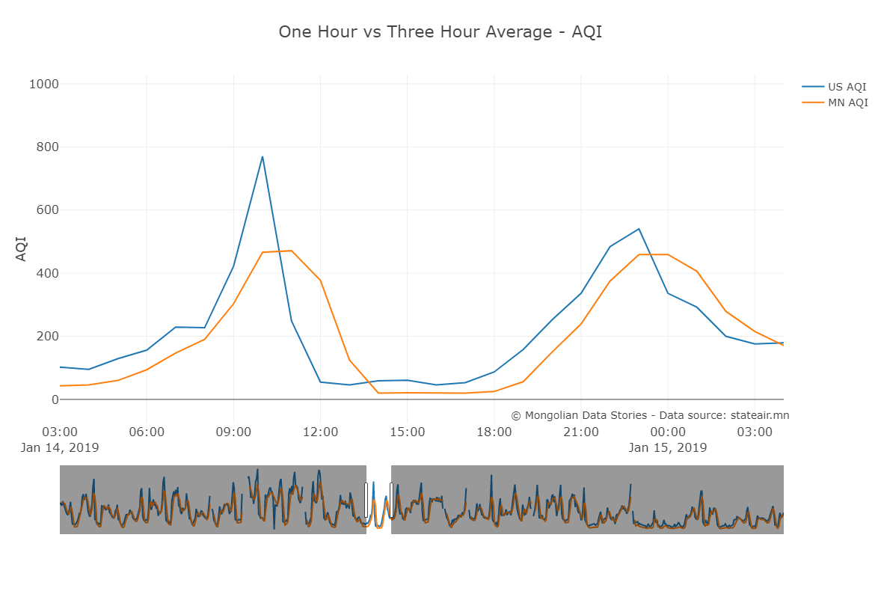

Slide 4
